Slide 1
Unit 6: File-System Interface
File Concept
Access :Methods
Directory Structure
Protection
Consistency Semantics
Operating System Concepts

Slide 2
File Concept
Contiguous logical address space
Types:
  Data
    numeric
    character
    binary
  Program
Operating System Concepts

Slide 3
File Structure
None - sequence of words, bytes
Simple record structure
  Lines
  Fixed length
  Variable length
Complex Structures
  Formatted document
Operating System Concepts

Slide 4
File Attributes
Name – only information kept in human-readable form.
Type – needed for systems that support different types.
Location – pointer to file location on device.
Size – current file size.
Protection – controls who can do reading, writing, executing.
Time, date, and user identification – data for protection, security, and usage monitoring.
Information about files are kept in the directory structure, which is maintained on the disk.
Operating System Concepts

Slide 5
File Operations
create
write
read
reposition within file – file seek
delete
truncate
open(F_{i}) – search the directory structure on disk for entry F_{i}, and move the content of entry to memory.
close (F_{i}) – move the content of entry F_{i} in memory to directory structure on disk.
Operating System Concepts

Slide 6
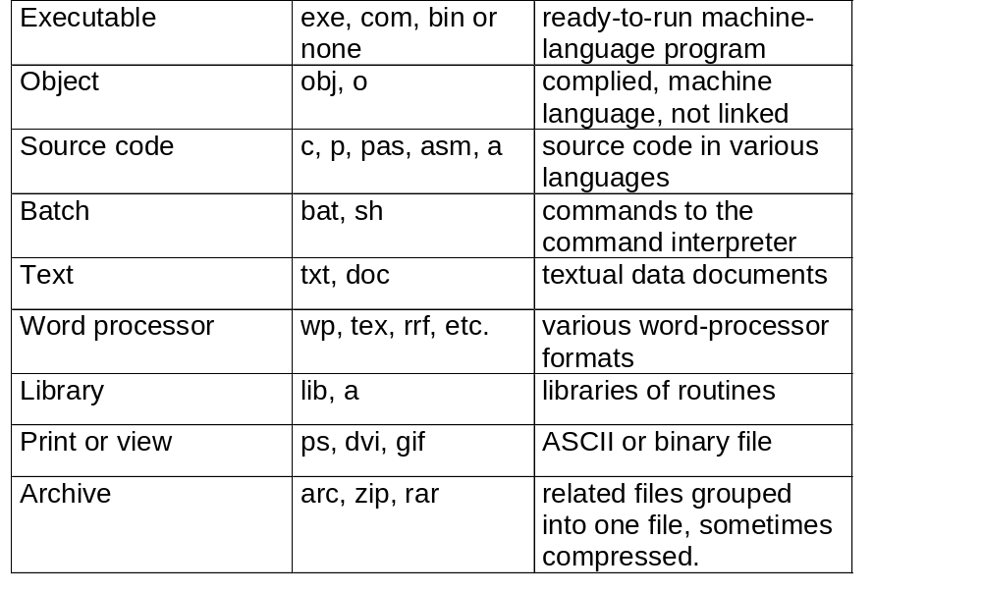
File Types – name, extension
Operating System Concepts

Slide 7
Access Methods
Sequential Access
read next
write next
reset
no read after last write
(rewrite)
Direct Access
read n
write n
position to n
read next
write next
rewrite n
n = relative block number
Operating System Concepts

Slide 8
Directory Structure
A collection of nodes containing information about all files.
Directory
Files
F 1
F 2
F 3
F 4
F n
Both the directory structure and the files reside on disk.
Backups of these two structures are kept on tapes.
Operating System Concepts

Slide 9
Information in a Device Directory
Name
Type
Address
Current length
Maximum length
Date last accessed
Date last updated
Owner ID
Protection information
Operating System Concepts

Slide 10
Operations Performed on Directory
Search for a file
Create a file
Delete a file
List a directory
Rename a file
Traverse the file system
Operating System Concepts

Slide 11
Organize the Directory (Logically) to Obtain
Efficiency – locating a file quickly.
Naming – convenient to users.
  Two users can have same name for different files.
  The same file can have several different names.
Grouping – logical grouping of files by properties, (e.g., all Pascal programs, all games, …)
Operating System Concepts

Slide 12

Single-Level Directory
A single directory for all users.
Naming problem
Grouping problem
Operating System Concepts

Slide 13

Two-Level Directory
Separate directory for each user (UFD)
Path name
Can have the same file name for different user
Efficient searching
No grouping capability
Operating System Concepts

Slide 14
Master File Directory
USER NAME | Pointer to UFD
Usr 1 | X
Usr 2 | Y
Usr 3 | Z
Usr 4 | M
Usr 5 | N
Operating System Concepts

Slide 15

Tree-Structured Directories
Operating System Concepts

Slide 16
Tree-Structured Directories (Cont.)
File -> 0
Subdirectory -> 1
Efficient searching
Grouping Capability
Current directory (working directory)
  cd /spell/mail/prog
  Absolute path name
  Relative path name
Operating System Concepts

Slide 17
Tree-Structured Directories (Cont.)
Absolute or relative path name
Creating a new file is done in current directory.
Delete a file
rm <file-name>
Creating a new subdirectory is done in current directory.
  mkdir <dir-name>
Example: if in current directory /spell/mail
mkdir count
mail
prog
copy
prt
exp
count
Deleting “mail” ⇒ deleting the entire subtree rooted by “mail”.
Operating System Concepts

Slide 18

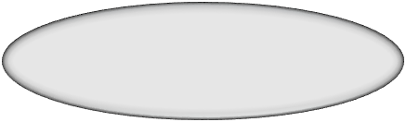

Acyclic-Graph Directories
Have shared subdirectories and files.
Shared directory
Shared File
Operating System Concepts

Slide 19
Acyclic-Graph Directories (Cont.)
Two different names (aliasing)
If dict deletes list ⇒ dangling pointer.
  UNIX and Windows let it up to the user to handle dangling pointers
Solutions:
  Backpointers, so we can delete all pointers: Variable size records a problem.
  Entry-hold-count solution: when count = 0 then only file is deleted
Operating System Concepts

Slide 20

General Graph Directory
Operating System Concepts

Slide 21
General Graph Directory (Cont.)
How do we guarantee no cycles in acyclic DS ?
  Allow only links to file not subdirectories.
  Garbage collection.
  Every time a new link is added use a cycle detection
  algorithm to determine whether it is OK.
Operating System Concepts

Slide 22
Protection
File owner/creator should be able to control:
  what can be done
  by whom
Types of access
  Read
  Write
  Execute
  Append
  Delete
  List
Operating System Concepts

Slide 23
Access Lists and Groups
Mode of access: read, write, execute
Three classes of users
RWX
a) owner access 7 ⇒ 1 1 1
RWX
b) groups access 6 ⇒ 1 1 0
RWX
c) public access 1 ⇒ 0 0 1
Ask manager to create a group (unique name), say G, and add some users to the group.
For a particular file (say game) or subdirectory, define an appropriate access.
owner
group
public
chmod
761
game
Attach a group to a file
chgrp G game
Operating System Concepts

Slide 24
Directory Implementation
Linear list of file names with pointer to the data blocks.
  simple to program
  time-consuming to execute
Hash Table – linear list with hash data structure.
  decreases directory search time
  collisions – situations where two file names hash to the same location
  fixed size
Operating System Concepts

Slide 25
File-System Structure
File structure
  Logical storage unit
  Collection of related information
File system resides on secondary storage (disks).
File system organized into layers.
File control block – storage structure consisting of information about a file.
Operating System Concepts

Slide 26
Contiguous Allocation
Each file occupies a set of contiguous blocks on the disk.
Simple – only starting location (block #) and length (number of blocks) are required.
Mapping from logical to physical is easy
Random access (sequential and direct both)
Drawbacks:
  Wasteful of space (dynamic storage-allocation problem).
  External Fragmentation
  Files cannot grow.
Operating System Concepts

Slide 27
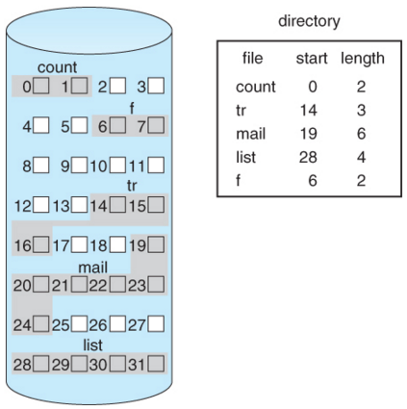
Contiguous Allocation
Operating System Concepts

Slide 28
Linked Allocation
Each file is a linked list of disk blocks: blocks may be scattered anywhere on the disk.
block 0
block 1
pointer
pointer
Operating System Concepts

Slide 29

Allocate as needed, link together; e.g., file starts at block 9
Operating System Concepts

Slide 30
Linked Allocation (Cont.)
Simple – need only starting address
Free-space management system – no waste of space
Drawbacks:
  No random access
  Logical to Physical Mapping is difficult
  Less Reliable
FAT
9
16
1
10
25
File-allocation table (FAT) – disk-space
allocation used by MS-DOS and OS/2.
Operating System Concepts

Slide 31
Indexed Allocation
Brings all pointers together into the index block.
Logical view.
index table
Operating System Concepts

Slide 32

Example of Indexed Allocation
Operating System Concepts

Slide 33
Indexed Allocation (Cont.)
Need index table
Random access
Dynamic access without external fragmentation, but have overhead of index block.
Mapping from logical to physical in a file of unbounded length
Linked scheme –
  Link blocks of index table (no limit on size).
Operating System Concepts

Slide 34
Indexed Allocation – (Cont.)

outer-index
index table
file
Operating System Concepts

Slide 35

Combined Scheme: UNIX (4K bytes per block)
Operating System Concepts

Slide 36
Free-Space Management
Bit vector (n blocks)
0
1
2
n-1
…
1 ⇒ block[ i ] free
0 ⇒ block[ i ] occupied
bit[ i ] =

Block number calculation
(number of bits per word) *
(number of 0-value words) +
offset of first 1 bit
Operating System Concepts

Slide 37
Free-Space Management (Cont.)
Bit map requires extra space. Example:
block size = 2¹² bytes
disk size = 2³⁰ bytes (1 gigabyte)
n = 2³⁰/2¹² = 2¹⁸ bits (or 32K bytes)
Easy to get contiguous files
Linked list (free list)
  Cannot get contiguous space easily
  No waste of space
Grouping
Counting
Operating System Concepts

Slide 38
Free-Space Management (Cont.)
Need to protect:
  Pointer to free list
  Bit map
    Must be kept on disk
    Copy in memory and disk may differ.
    Cannot allow for block[i] to have a situation where bit[i] = 1 in memory and bit[i] = 0 on disk.
  Solution:
    Set bit[i] = 1 in disk.
    Allocate block[i]
    Set bit[i] = 1 in memory
Operating System Concepts

Slide 39
Efficiency and Performance
Efficiency dependent on:
  disk allocation and directory algorithms
  types of data kept in file’s directory entry
Performance
  disk cache – separate section of main memory for frequently sued blocks
  free-behind and read-ahead – techniques to optimize sequential access
  improve PC performance by dedicating section of memroy as virtual disk, or RAM disk.
Operating System Concepts

Slide 40

Various Disk-Caching Locations
Operating System Concepts

Slide 41
Recovery
Consistency checker – compares data in directory structure with data blocks on disk, and tries to fix inconsistencies.
Backup and Restore – Use system programs to back up data from disk to another storage device (floppy disk, magnetic tape). Recover lost file or disk by restoring data from ba
  Day 1: Full Backup
  Day 2: Incremental Backup
  Day 3: Incremental Backup
  .
  .
  .
  Day N: Incremental Backup
Operating System Concepts

